Slide 1
Recitation 1: User Stories
February 2, 2021

Slide 2
Welcome!
My name: Sean Prendi
My Email Address: sprendi@andrew.cmu.edu
My Office hours: Sundays, 12pm – 2pm (tentatively)

Slide 3


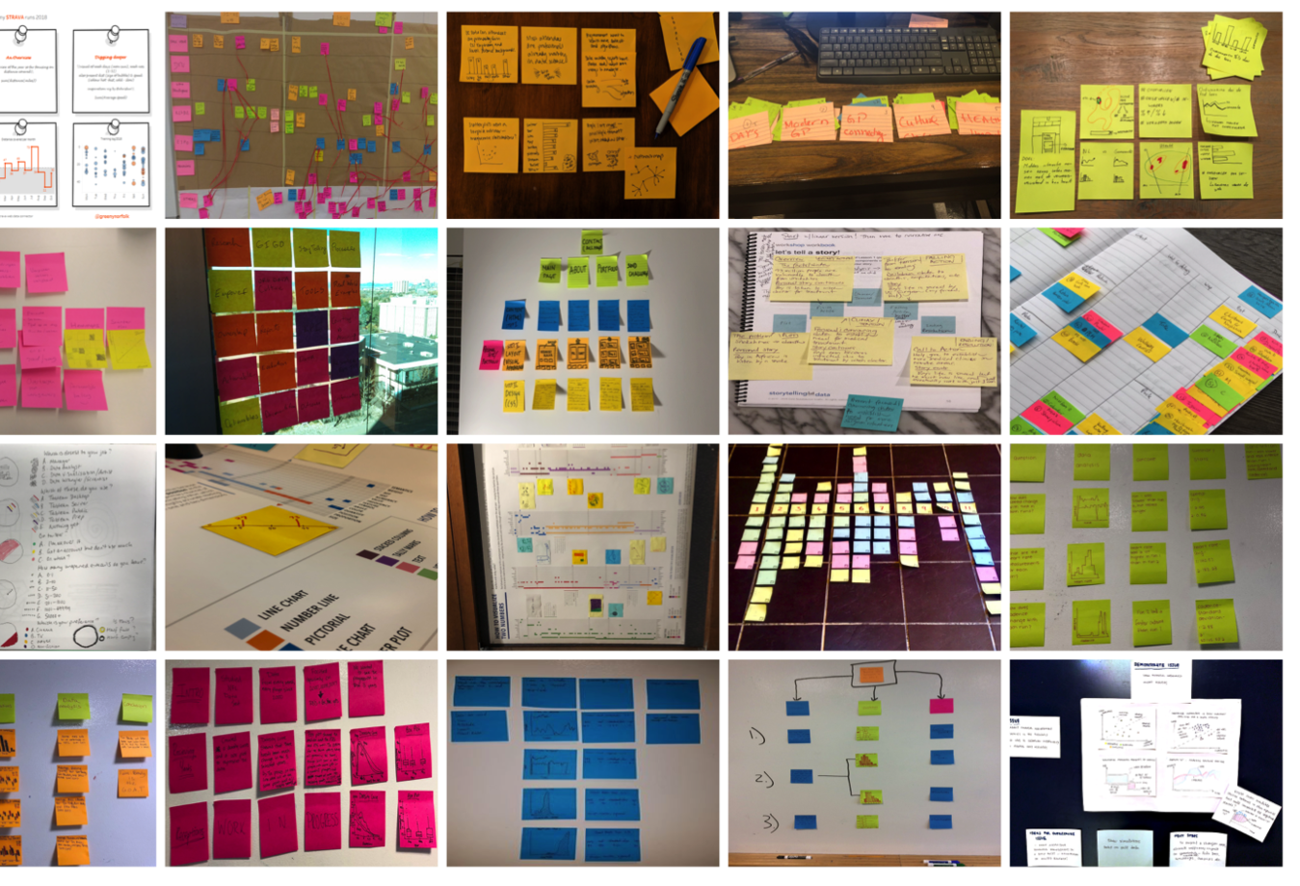




Slide 4
What are they?
Capture a description of a software feature from an end-user perspective
Are used for planning
Facilitate conversation among users, stakeholders, developers and etc.

Slide 5

User Story Template
As a (type of user),
I want (some feature),
so that (some benefit)

Slide 6
Job Portal Example
As a job seeker,
I want to upload my resume, so that employers consider me for jobs

Slide 7
Epics vs user stories
As a user, I want to sort available jobs by their relevance to my field…
Epic:
Browse jobs
As a user, I want to search for jobs by experience required

Slide 8
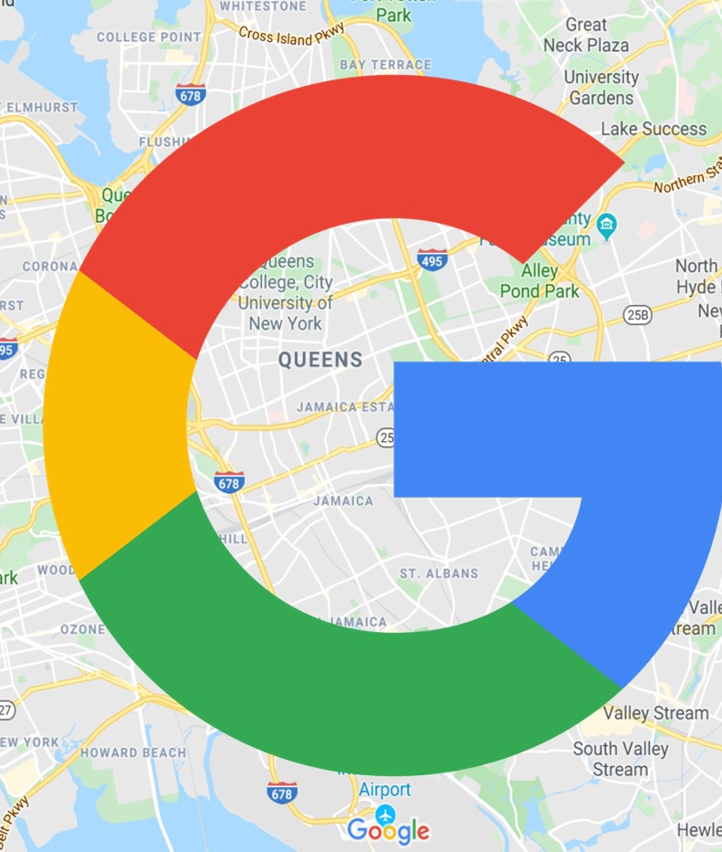
A case study

Slide 9
What makes a good user story
I
N
V
E
S
T
ndependent
egotiable
aluable
stimable
mall
estable

Slide 10
Google Maps User Stories
Example:
As a delivery driver I would like to be able to have multiple destinations so that I can maximize tips by doing multiple deliveries as fast as possible
Now, suggest some more user stories for Google Maps:

Slide 11
INVEST
What are the benefits of invest?
What are the issues with the INVEST approach?
Notes:
How do I present and screen share on OhYay? How do I upload the recitation slides? How long should my OH be? Can I end recitation early if we have extra time?

Slide 12
Let’s try it
Capture a description of a software feature from an end-user perspective
(As as class) Let’s come up with a small example application
Brainstorm and write 5-10 user stories

Slide 13
3 CS Approach
Card: The user stories written on cards by customer/product owner
Conversation: The communication between customer/product owner and developers
Confirmation: Acceptance criteria/test

Slide 14
Homework 1
Available on the course website now

